Slide 1

GPIP: Wisconsin Breast Cancer Data Analysis
By: Joshua Zacharias
Date: 08/12/2025

Slide 2

Introduction to Breast Cancer
How breast cancer starts
Where lumps form
Wisconsin Breast Cancer Dataset
Tumor type classification
Notes:
Breast Cancer starts when cells grow out of control, which in turn creates lumps.. These lumps can form in various parts of the breast in both men and women, although they are more commonly found in women. The lumps can be classified into two tumor types: either malignant (meaning the lumps are cancerous) or benign (meaning the lumps are non-cancerous)
The Wisconsin Breast Cancer Dataset is a dataset that was created to aid in the diagnosis of breast cancer. There are 30 features in this data set that we will cover but the data set can be grouped into 3 groups: mean (the average of the feature being measured), worst( the largest or most extreme values), and the standard error (just the variation of the feature).
Tumors can be classified into two types: either malignant which means the tumor is cancerous or benign which means the tumor is non-cancerous

Slide 3
Analysis Plan
Data Exploration: How is each feature distributed? Are any pairs of features correlated? Outliers?
Heat Map, pair plots, bar graphs, box plots
Tumor Classification: Using machine learning models, can we predict the tumor types?
Logistic Regression, SVM model
Feature Importance: In finding tumor types, which features are key factors?
Random Forest

Slide 4
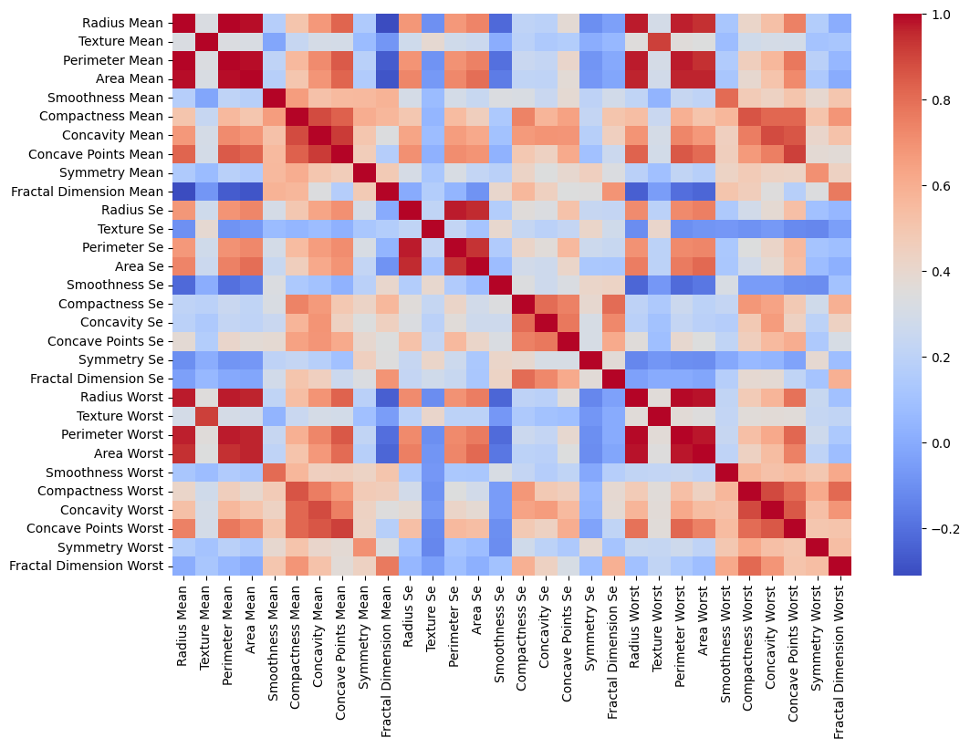
EDA: Correlation Heatmap in the data

Slide 5
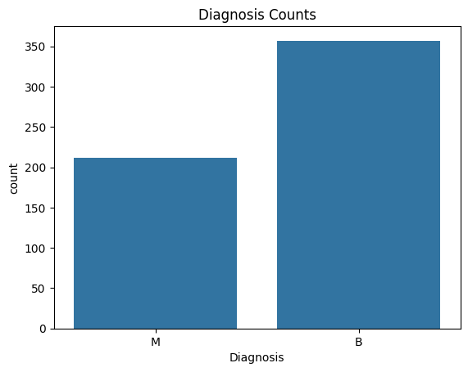
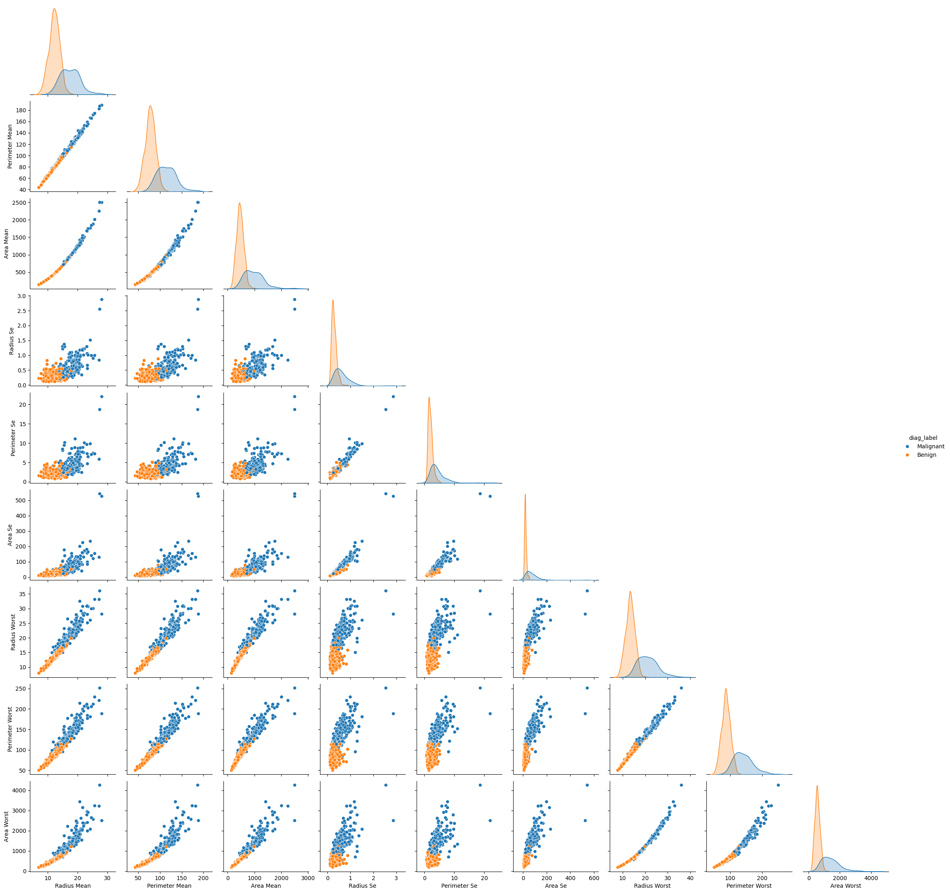
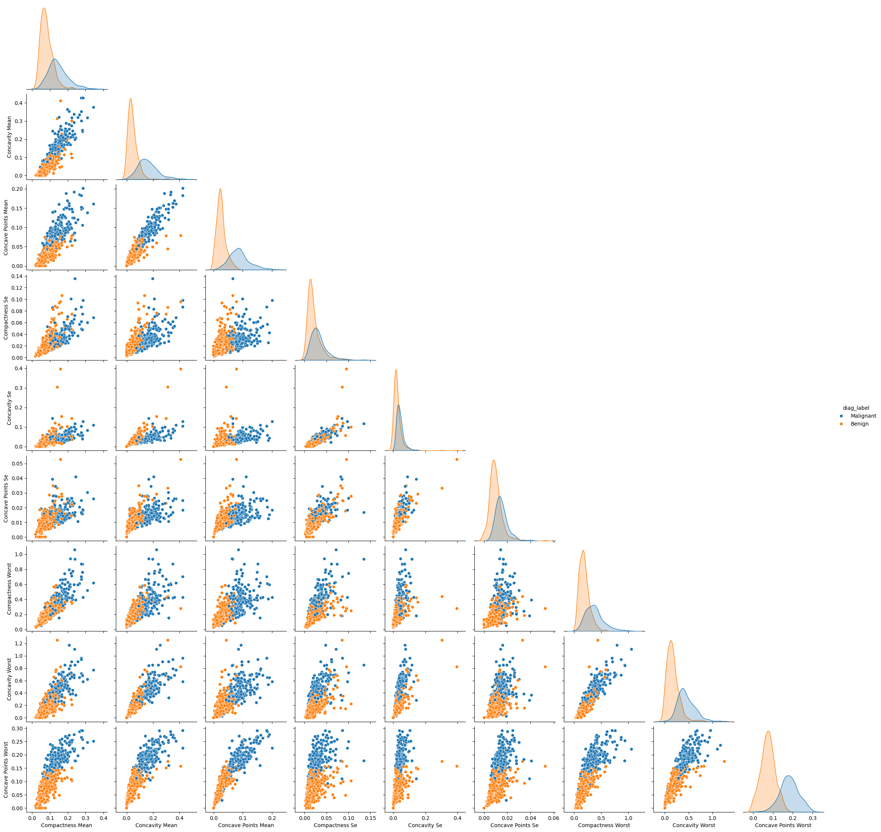
EDA: Pairplots of size and shape
Size
Shape

Slide 6
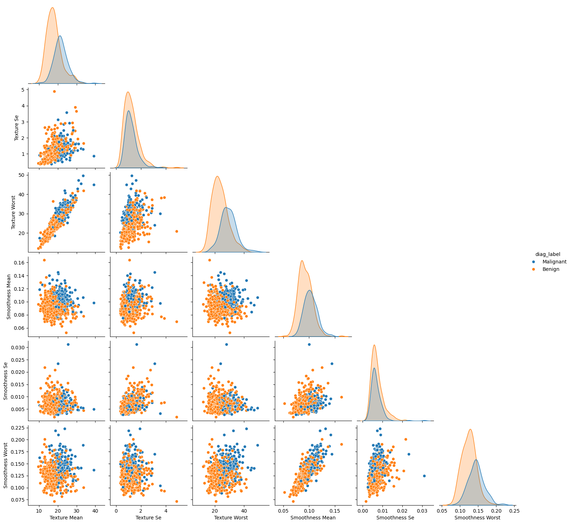
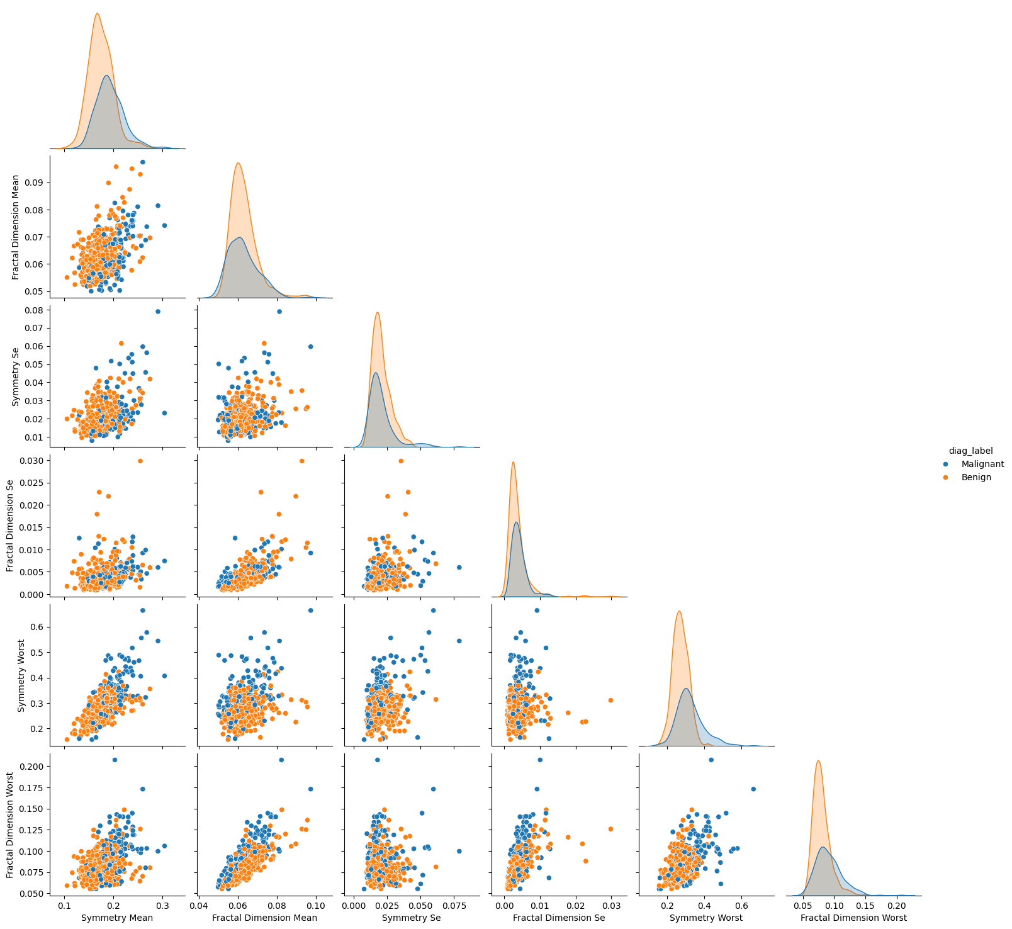
EDA: Pairplots of texture and symmetry
Symmetry
Texture

Slide 7
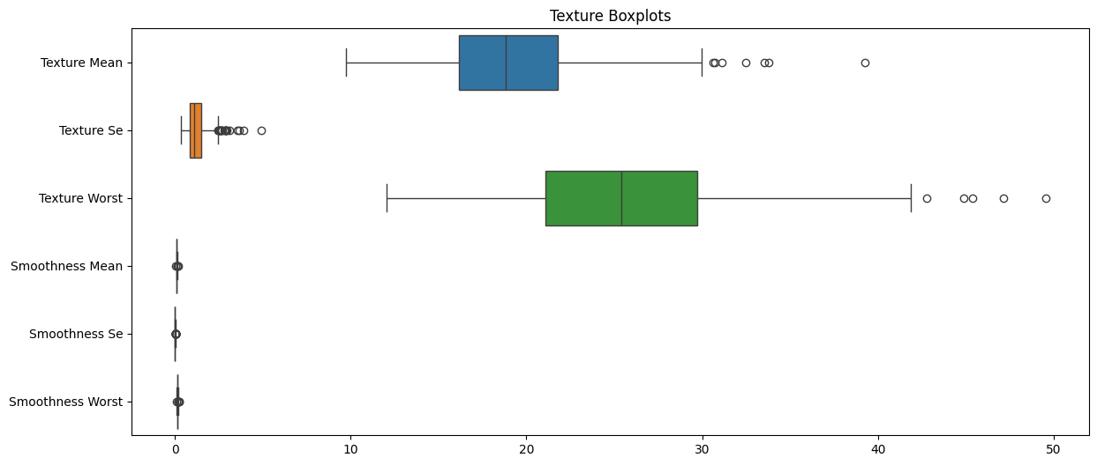
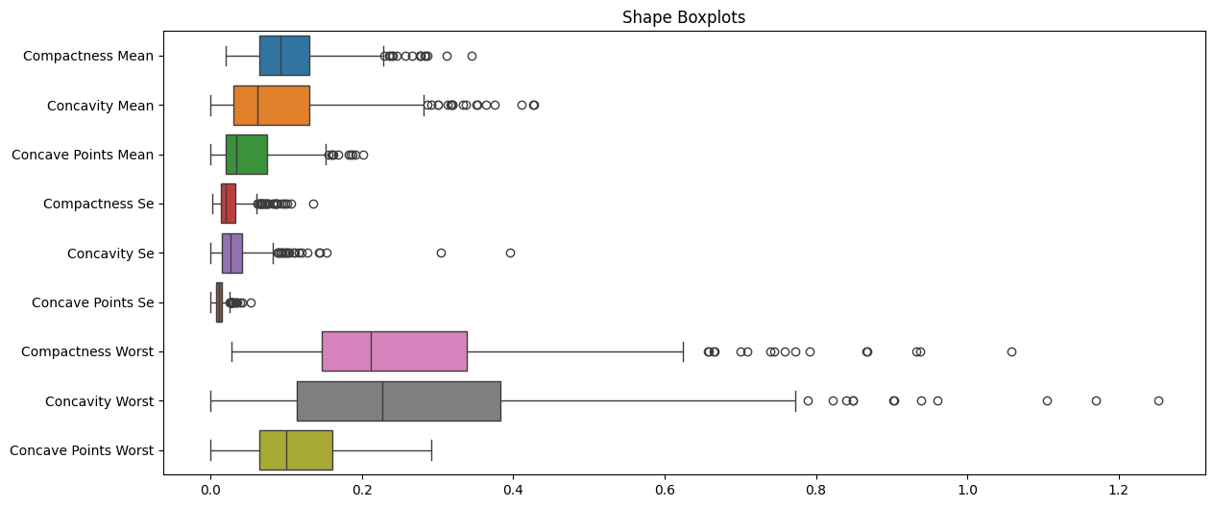
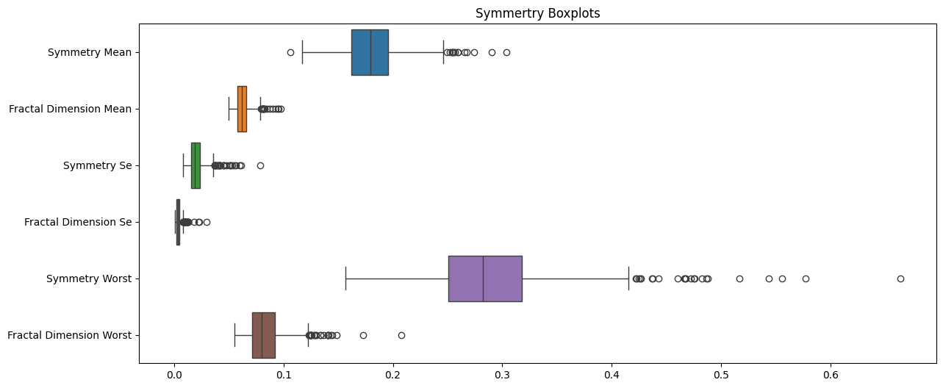
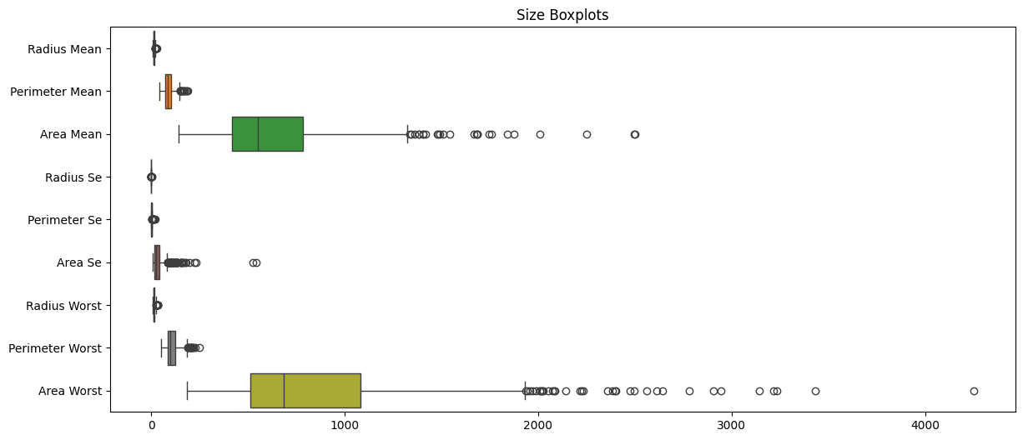
EDA: Boxplots show how data is spread

Slide 8
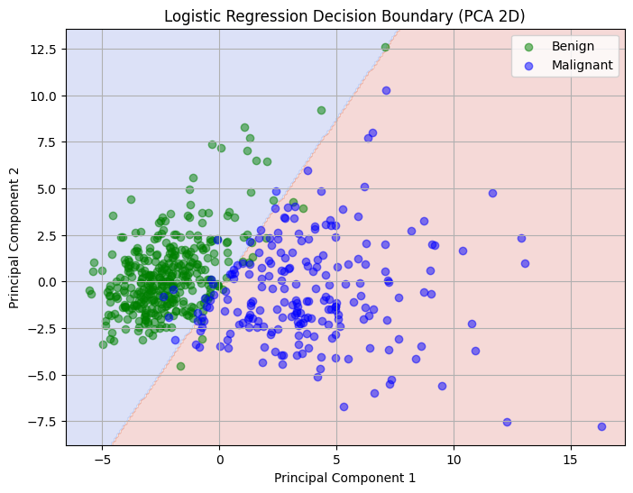
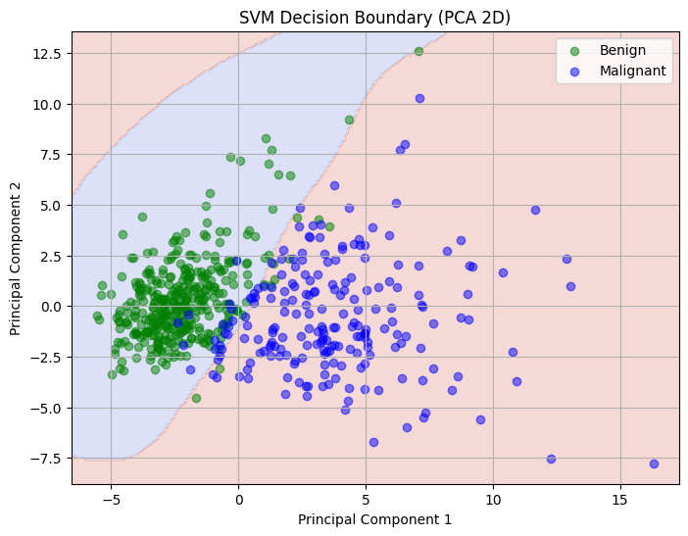
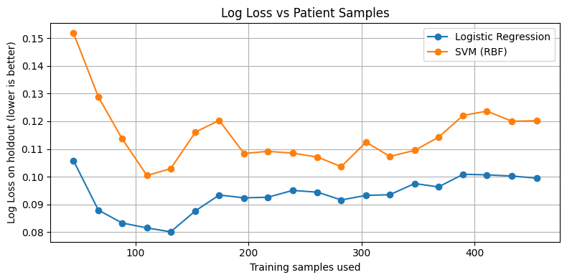
Classification of tumor types: Logistic Regression vs. SVM
 | Confusion Matrix | Accuracy
LR | [[347 10] [ 15 197]] | 0.9561
SVM | [[346 11] [ 21 191]] | 0.9438
 | Precision | Recall | F1 Score | Support
Benign | 0.96 | 0.97 | 0.97 | 357
Malignant | 0.95 | 0.93 | 0.94 | 212
Accuracy |  |  | 0.96 | 569
Macro avg | 0.96 | 0.95 | 0.95 | 569
Weighted Avg | 0.96 | 0.96 | 0.96 | 569
 | PC1 | PC2
Concave Points Mean | 0.260854 | 0.034768
Concavity Mean | 0.258400 | 0.060165
Concave Points Worst | 0.250886 | 0.008257
Compactness Mean | 0.2392825 | 0.151892
Perimeter Worst | 0.236640 | 0.199878

Slide 9
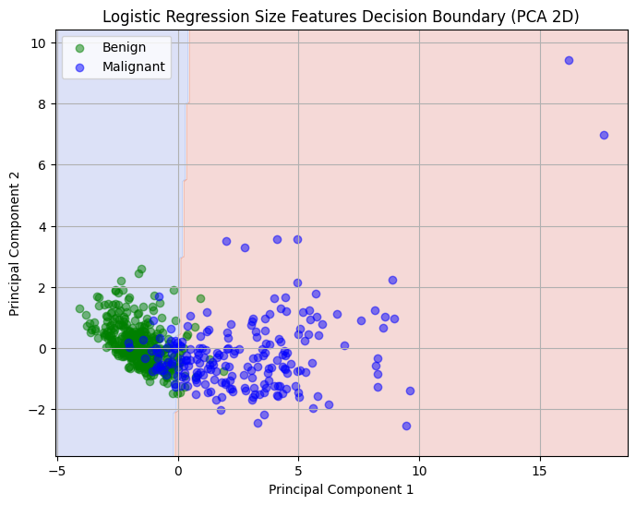
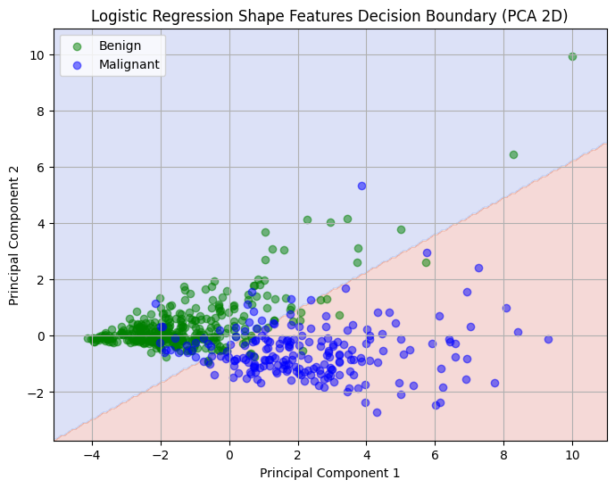
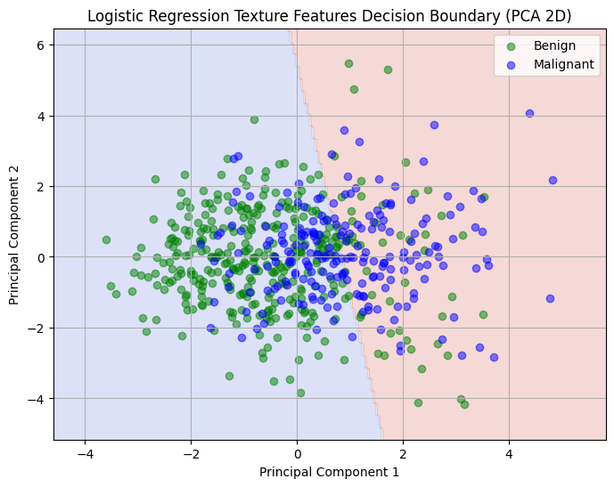
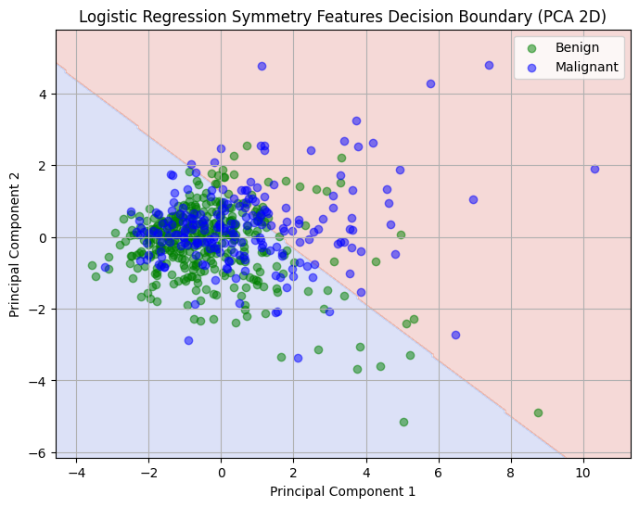
Classification (continued)
Category 1: Size
Category 2: Shape
Category 3: Texture
Category 4: Symmetry
 | PC1 | PC2
Area Mean | 0.34786 | 0.183004
 | PC1 | PC2
Concavity Mean | 0.369492 | 0.092350
 | PC1 | PC2
Texture Worst | 0.537795 | 0.343535
 | PC1 | PC2
Fractal Dimension Mean | 0.469590 | 0.341992
 | Precision | Recall | F1 Score
Benign | 0.90 | 0.95 | 0.93
Malignant | 0.91 | 0.83 | 0.87
Accuracy |  |  | 0.91
Macro avg | 0.91 | 0.89 | 0.90
Weighted Avg | 0.91 | 0.91 | 0.91
 | Precision | Recall | F1 Score
Benign | 0.92 | 0.94 | 0.93
Malignant | 0.90 | 0.85 | 0.87
Accuracy |  |  | 0.91
Macro avg | 0.91 | 0.90 | 0.90
Weighted Avg | 0.91 | 0.91 | 0.91
 | Precision | Recall | F1 Score
Benign | 0.74 | 0.85 | 0.79
Malignant | 0.66 | 0.49 | 0.56
Accuracy |  |  | 0.72
Macro avg | 0.70 | 0.67 | 0.68
Weighted Avg | 0.71 | 0.72 | 0.71
 | Precision | Recall | F1 Score
Benign | 0.69 | 0.89 | 0.78
Malignant | 0.65 | 0.33 | 0.44
Accuracy |  |  | 0.69
Macro avg | 0.67 | 0.61 | 0.61
Weighted Avg | 0.68 | 0.69 | 0.65
Notes:
Shape catches more Malignant
While size picks up fewer false benign.

Slide 10
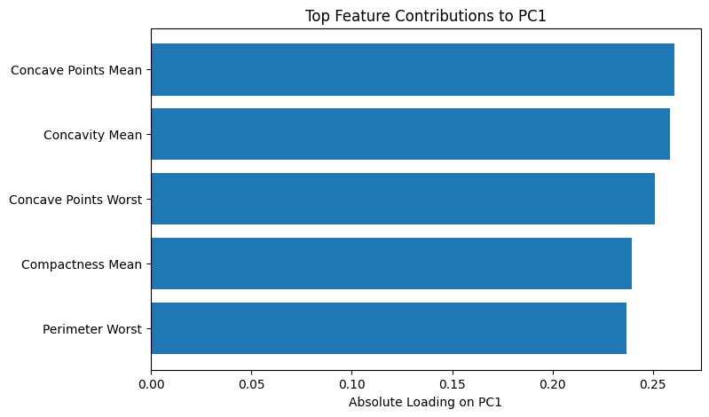
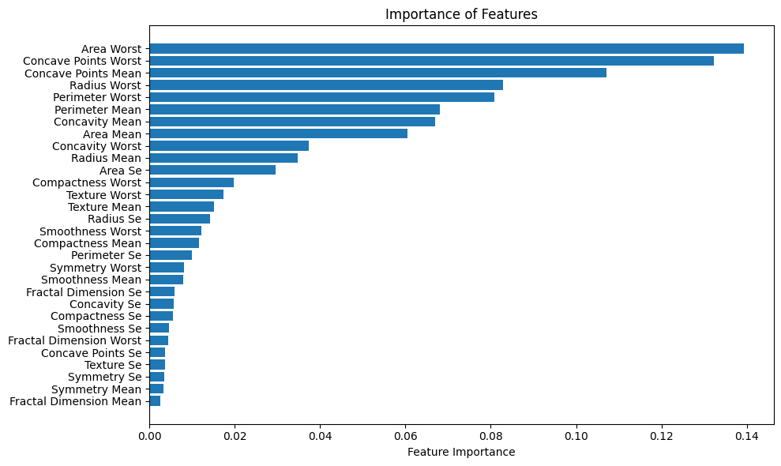
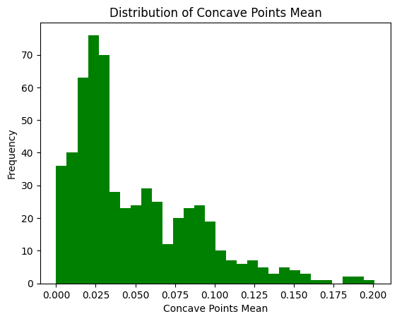
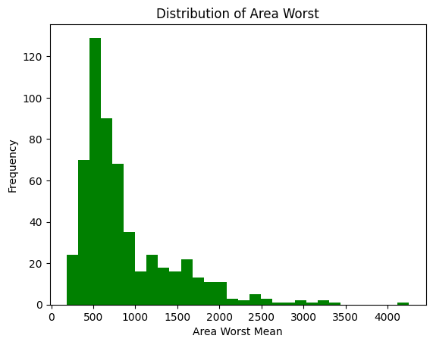
Feature Importance
Decision Forest
The area worst is the most influential
PC1 table readings
Concave Points mean that the data varies the most

Slide 11
Conclusion
The best model to predict the classification of the type of tumor is logistic regression.
Area Worst is the most influential feature in tumor type prediction.
Concave Mean varies the most in PC1 (is highly variable)

Slide 12
Acknowledgements
Special thanks to:
UIC
Dr. Dai
Mehrdad

